Slide 1
Growth Mindset Parent Night - Session II
Welcome to
May 31, 2017
Notes:
DEBBIE
6:35 Welcome families
Kids go to child care with Troy and Mary
Intro staff: Caitilin, Dawn, Kristin, Rachel Cook, and Christine

Slide 2
Tonight’s Outcomes
Recap of Session I
Watch video clip on “Praising Effort vs Praising Intelligence” Study
Reflect and discuss our mindset towards failure
Promote steps toward action
Q & A
Notes:
CHRISTINE

Slide 3
Recap of Session 1
What is Growth Mindset?
Power of Yet
Remember our scenarios to practice Growth Mindset phrases
Notes:
CHRISTINE
Give out new hand out on Growth Mindset and Fixed Mindset definitions and phrases
Power of Yet
Have old posters displayed.

Slide 4
Praise
Notes:
6:42? CAITILIN: 5 min. - video clip
Discuss with an elbow partner anything surprising.

Slide 5
Elbow Partner
Share your thoughts with a neighbor: What is something that stood out to you?
Notes:
CAITILIN

Slide 6
What is our Mindset on Failure?
Let’s try this:
https://www.mindsetkit.org/growth-mindset-parents/how-parents-can-instill-growth-mindset/activity-reflect-on-your-failure-mindset
Notes:
6:50? DAWN

Slide 7
Why Should We Talk about Failure?
Modeling a growth mindset means being willing to try hard even if you fail, because that's how growth happens.
Children start to think of mistakes as a natural part of the learning process. This leads to a few important changes in learning behavior:
Children stop avoiding challenging work just because it could mean making more mistakes.
Children become less likely to try to "sweep mistakes under the rug" because they stop thinking of them as something to be ashamed of.
Notes:
DAWN
Modeling a growth mindset means being willing to try hard even when failure is likely because that's how growth happens. For example, parents should try to get excited when their children make mistakes because these mistakes can reveal important conceptual gaps that should be filled. When adults get excited about the learning that mistakes can facilitate, children start to think of mistakes as a natural part of the learning process. This leads to a few important changes in learning behavior:

Slide 8
Action Ideas
At the dinner table, talk about a time that you struggled with something and how you overcame it. Then ask your kids if there's anything they struggled with, how they overcome it, and what they learned from the experience.
Get excited when your child makes a mistake and help her think through what could be learned from it.
Notes:
DAWN
From: https://www.mindsetkit.org/growth-mindset-parents/how-parents-can-instill-growth-mindset/model-making-mistakes
Even mistakes that seem careless can be good learning opportunities. For example, if your child forgot to study enough for an important test, it might be an opportunity to learn about prioritization and to-do-lists.

Slide 9
Famous Failures
Notes:
6:57? KRISTIN
1 min. Video clip

Slide 10
Community Circles
Directions:
Form a circle with your group.
Go around the circle and share your thoughts when the talking piece comes to you.
Feel free to pass if you are not ready to share.
Just listen, don’t comment on what other people say.
Question:
What is one of your failures? How did you overcome it?
Notes:
6:58-7:08? KRISTIN
10 min.
Explain what a community circle is and how our students are using it.
We’ll form groups - So far, 44 people RSVP’d so maybe we’ll do groups of 7 or 8? Hopefully we can all help facilitate a group or buddy up to facilitate.

Slide 11
Action Ideas for Table Groups
When you hear or provide praise, ask yourself, "What is being praised?"
Is it effort, strategy, persistence, focus, and improvement, or does it sound more like a fixed trait or ability?
When you or your child makes a mistake, ask yourself, “How does my reaction influence my child’s future behavior?”
Does it encourage learning and growth, or does it encourage them to avoid challenges in the future?
Notes:
7:09? Rachel Cook
Distribute poster paper with the questions in the middle so that participants can make a web of responses.

Slide 12
Table Group Talk
Read the Action Ideas and discuss with your table group.
Jot down any ideas, highlights, or questions.
Notes:
7:10-7:18? Rachel Cook

Slide 13
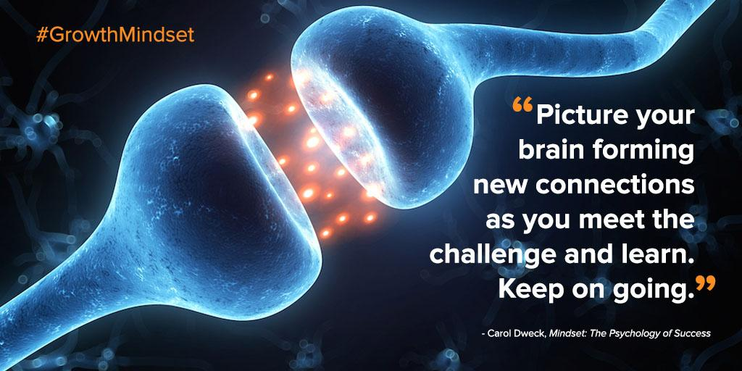
Notes:
Rachel Cook
Remind about teaching neuroplasticity. Children who learn about the brain being a muscle to train develop a stronger sense of growth mindset.
Also remind ourselves as parents that we may mistakes, but can learn from them as we model this process for our children.

Slide 14
What Questions Do You Have?
Here are some examples:
Is it OK to give up? To stop?
What if it is too hard?
But don’t grades really matter?
What if the effort isn’t enough?
Notes:
7:20?
CHRISTINE and anyone can jump in to help with the discussion!
Let’s have a discussion.

Slide 15
Growth Mindset Quotes and Feedback Forms
Action Idea:
Choose a quote each day to discuss for your own family “community circle.”
Feedback Forms:
Let us know what you think!

Slide 16
Works Cited
Creating success --> Growth Mindset. (n.d.). Retrieved April 30, 2017, from https://www.pinterest.com/audreynay/creating-success-growth-mindset/?lp=true
Dweck, C. S. (2006). Mindset: the new psychology of success. New York: Random House.
Growth Mindset for Parents Course. (n.d.). Retrieved April 30,, 2017, from https://www.mindsetkit.org/growth-mindset-parents
How Parents Can Instill a Growth Mindset at Home. (n.d.). Retrieved April 30,, 2017, from https://www.mindsetworks.com/parents/growth-mindset-parenting
S. (2014, January 30). Carol Dweck - A Study on Praise and Mindsets. Retrieved August 20, 2017, from https://www.youtube.com/watch?v=NWv1VdDeoRY
Yurchuk, G. (2016, July 07). Greg Yurchuk. Retrieved April 30,, 2017, from https://www.thinkthroughmath.com/growth-mindset-quotes/
A. (2007, December 11). Famous Failures. Retrieved February 01, 2017, from https://www.youtube.com/watch?v=Y6hz_s2XIAU&index=1&list=PLr6goqMhw8VrDbDjSC4yP7c-pm18ZCtWs

Slide 17
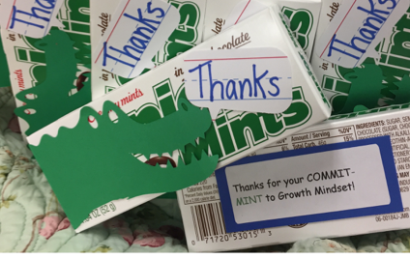
Thanks for your COMMIT-MINT to Growth Mindset!

